Slide 1
Site visit report of the Global Fund supported program implementation
20 November, 2018
CCM Secretariat
S.Enkhjin, CCM Oversight Committee member

Slide 2
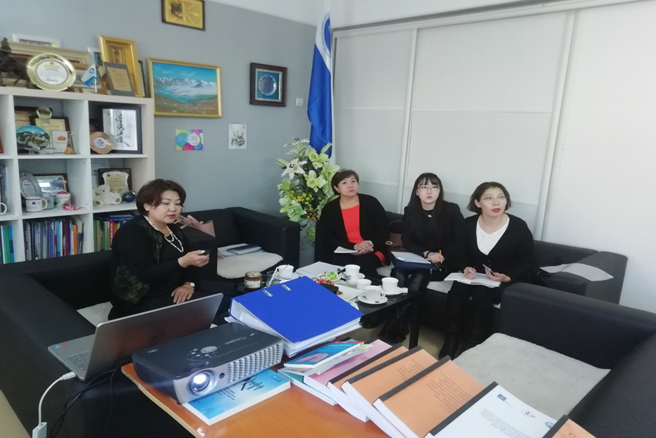
Visited sites and working group components, Team 2
Covered areas:
Mongolian Association of Family Medicine Specialists (MAFMS)
Mongolian Child Adolescents Support Center
Team members:
R.Oyungerel, Associate Professor MD, PhD, Head, Department of Infectious diseases, School of Medicine, MNUMS and President, Mongolian Society of Infectionists
B.Bayarmaa, Perfect Ladies NGO
S.Enkhjin, MOH, monitoring and evaluation department
L.Nomin-Erdene, CCM secretariat assistant

Slide 3
Mongolian Association of Family Medicine Specialists (MAFMS)
Achievements
Implementation is focusing on the target group.
168 medical doctors and specialists of the Family Health Center’s engagement to tuberculosis care and services reduce the burden of TB dispensaries, and the capability of specialized doctors and specialists have improved, and access to service has increased.
The TB care and service approaches to a community.
20809 people with pneumonia suspected, 20879 people were sent to TB dispensaries, 2106 specimens were transported 1634 times at regular intervals to detect 909 new TB cases, detection has been increased and monitoring has improved.
TB treatment was provided to approximately 30% of the cases. The success of treatment is 84%.
As of 2017, 21.5% of new TB cases were identified at provinces and district levels, and 22% of new TB cases were detected at the national level.

Slide 4
Obstacles
Building sufficient cooperation with the government, necessary to take measures to increase the amount of funding from the Social Insurance Fund to one citizen expenditure of the Family Health Center.
Suggestions
Sustainability of human resource management of FHC (40 per cent change in human resources annually, which reduces work efficiency).
Family Medicine Centers’ doctors/physicians and professionals need to receive incentives in order to get efficient results.
Empowering re-training for doctors/physicians to improve the linkage between the Family Medicine Center and Dispensary.
Strengthen and improve advocating activities on the population
Involve homeless and unemployed people in social welfare services.

Slide 5
Mongolian Child Adolescents Support Center
Achievements
Implementation is focusing on the target group.
After conducting "Open your eyes" and “Magical world“ training, participants request to receive training manuals and materials to conduct training in their local area.
Providing health education to the public, behavioral change training and promotional activities are actively organized.

Slide 6
Obstacles
Program implementation usually delayed because the budget doesn't arrive on time.
Government experts are constantly changing, which make us hard to collaborate and implement our activities.
Adolescents' participation is very strong, but students from universities and VTPC are less active.

Slide 7
Conclusion
Finance
Consider on to timely disbursement of funds.
1
Procurement
  Provide necessary products, inventory, textbooks and printed materials.
2
Implementation
  Activities are implemented on time, but there is a lack of human resources.
3
Result
  Focus on improving the outcome of the GF supported programs.
4
5
Suggestion
  CCM members can make recommendations for improvement.

Slide 8
Thank you for your consideration.

