Slide 1
Oversight site visit report in UB
CCM meeting

Slide 2
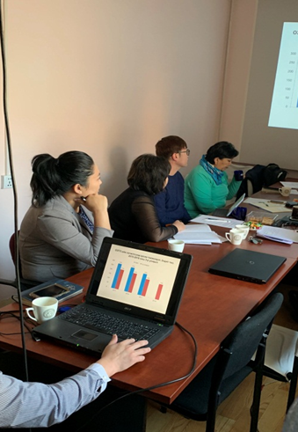
Sub-recipients
Team 1, November 20, 2018
Organizations:
TB NTP of NCCD
STI dept of NCCD,
Association of Mongolian Soum doctors and specialists
Participated:
A.Tsetsegmaa, CCM Oversight committee member
Ts.Davaasuren, CCM Oversight committee member
G.Nyampurev, CCM Oversight committee member
B.Oyundari, CCM Coordinator

Slide 3
1. TB NTP of NCCD
Consists of 46 doctors and specialists, worked as TGF supported grant sub-recipent since 2003.

Slide 4
TB NTP of NCCD
Achievement
Bottleneck
Increased diagnoistic capacity.
(Mobile xray-15,
NCCD-2, Gene xpert 14+6)
Active screening.
Drug resistant TB patients number
increased
Procurement of Drug resistant TB
drug
Lack of financial officer, doctors are responsible for the timely financial reports apart from the work duty.
Funding recipient process is slow. The process takes time from the State Fund.
Procured drugs/equipment being delayed at the toll.

Slide 5
TB NTP of NCCD
Overall:
Grant implementation activities should be done on time
PCU officers should provide TA in spot
Notes:
Төслийн үйл ажиллагааг төлөвлөгөөний дагуу хийгдэх боломжоор хангуулах тэр дундаа Үндсэн хүлээн авагч байгууллага асуудлыг дор нь шийдвэрлэж, албан бичгүүдэд цаг тухайд нь хариу өгч, дэмжиж ажиллах шаардлагатай байна. Мөн ханган нийлүүлэлт ялангуяа эмийн тооцоолол, санхүүгийн тайлан болон төслийн холбогдох бусад асуудлаар ХЗН-ийн мэргэжилтэнгүүд ажлын байран дээр арга зүйн дэмжлэг үзүүлж байх шаардлагатай байна.
Мөн ханган нийлүүлэлт ялангуяа эмийн тооцоолол, санхүүгийн тайлан болон төслийн холбогдох бусад асуудлаар ХЗН-ийн мэргэжилтэнгүүд ажлын байран дээр арга зүйн дэмжлэг үзүүлж байх шаардлагатай байна.

Slide 6
TB NTP of NCCD
Recommendation:
1.
Support of drug specialist of TB
2.
Hire financial officer, provide with incentive
3.
4.
5.
6.
Liaise financial report with programmatic data
Renovation of warehouse
Close collaboration with PR, tackle with grant implementation bottlenecks
Supply all procured equipment on time
7.
Oversee the procured equipment utilization

Slide 7
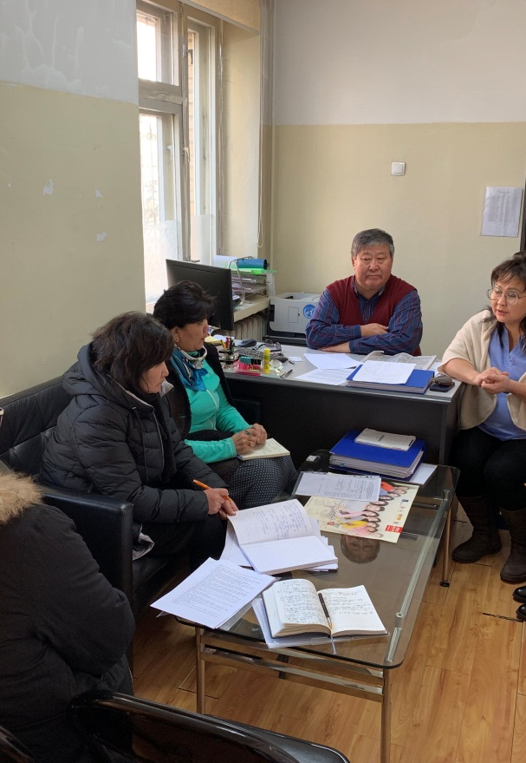
2.STI dept of NCCD
Worked as TGF SR since 2003.
Close collaboration with NGOs
Consists of 2 depts: STI
          HIV/AIDS

Slide 8
STI dept of NCCD
Zero HIV contraction from mother to baby.
Training has conducted to all doctors of maternal hospitals. HIV positive mothers has given birth to belonging maternal hospitals since 2017.
Research says 12000 people survived from HIV due to TGF grant implementation.
Achievements
3rd and 4th quarter funding has been delayed at MoF.
Need of intensifying funding process.
Lack of doctors and specialists.
Bottlenecks

Slide 9
STI dept of NCCD
Recommendation:
1.
Need of PRs attention to grant implementation on time. Assist on funding delay.
2.
PCU should search for avenues to support SRs, get CCM support when necessary

Slide 10

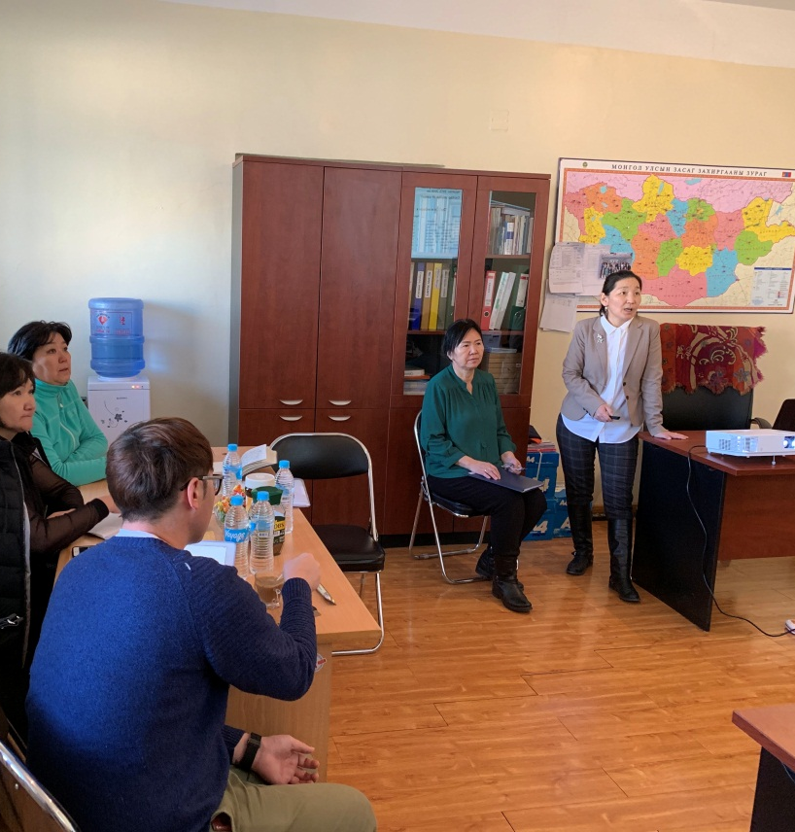
3. Association for Mongolian soum doctors and specialists
Founded in 2012, has 21 branches
Worked as TGF grant SR since 2016
Structure: program coordinator-1,sputum doctor-2, accountant-1

Slide 11
Association for Mongolian soum doctors and specialists
Achievements
Bottleneck
Increase of TB diagnosis
Sputum transportation cost has been delayed.

Slide 12
Association for Mongolian soum doctors and specialists
Recommendation
PR and PCU should present the method on how to conduct the prevention screening for remote population.

Slide 13
IN GENERAL
Joint collaboration
- Insufficient usage of equipment
- Outcome
- Day to day activity vs grant activity /Main duty, financial report/
Transition and sustainability of grants
- Procurement of MDR TB 80% - TGF
- procurement of condoms

Slide 14
IN GENERAL
Support from MoH, MoF, PCU
- funding delay
- late decisions
- joint collaboration

