Slide 1
Site visit report of the Global Fund supported program implementation in Uvs, Zavkhan provinces
22-26 of January, 2019
CCM Secretariat
Ts.Adiyakhishig, CCM member

Slide 2
Visited sites and working group components
Covered areas :
Uvs province
Governor's Office
Department of Health
General Hospital
Mongolian Association of Family Medicine Specialists (MAFMS)
Zavkhan province
Citizens Representative's Assembly
Department of Health
General Hospital
Mongolian Association of Family Medicine Specialists (MAFMS)
Team members:
J.Munkhjargal- Governmental org. representative of CCM
Ts.Adiyakhishig-Governmental org. representative of CCM
G.Nyampurev-KAP representative of CCM
B.Oyundari- CCM secretariat coordinator
B.Oyunbeleg- STI Department of NCCD
D.Dorjmaa- TB department of NCCD

Slide 3
“Health Department of Uvs province”
General information
2019.01.22-23
614 infectious diseases’ cases were detected in 2018.
Tuberculosis-6.3%,
Gonorrhea-15.9%,
Syphilis-21% ,
Trichimoniasis-11.7% .
TB incidence detection in 2018: 13 new cases in the soum and 39 cases in a province. 3 HIV infection recorded in province and no HIV infection has been reported from mother to infant.
The General hospital received the GF funded mobile X-ray apparatus in November 2018. There are two military armies in the province and actively carried out tuberculosis examination using a mobile digital X-ray apparatus. Last year, a total of 880 people were involved in TB examination in four soums of Uvs province, of which 14 suspects were, 2 diagnosed with tuberculosis. STI incidences are more likely to decrease.

Slide 4
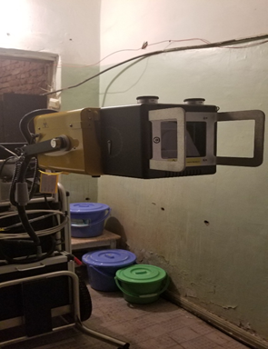
The list of the TGF supported procurements
№ | Equipment | Country | Dates | Serial | Quantity
1 | Microscopy | Japan | 2007 | Olmpus | 1
2 | Desar | Russia | 2009 | Кронт | 1
3 | Autoclave (portable) | China | 2008 | YX-280D | 1
4 | Quartz (portable) | China | 2006 | SJD-I | 1
5 | Mechanical scale | Japan | 1999 |  | 1
6 | Dryer | China | 2013 | DH4000 | 1
7 | Computer (Dell) | China | 2013 | Dell | 1
8 | Mobile X-ray apparatus | USA | 2018 | HF 120/60 | 1
Mobile X-ray apparatus installation

Slide 5
STI cabinet and VCT center
Condition
Obstacles
A total of 4889 people were screened for HIV and 4498 for syphilis in 2018. Non-pregnant 465 people were served at VCT Center.
Procurement orders are based on aimag and soum hospitals’ requirement. Condoms distributed to VCT center and hotels, hence visited to monitor 2 or 3 times in a year.
Without infection in the fetus, HIV-infected 2 women gave birth. Infected person’s data is saved by code.
Since the number of staff and labor is short, VCT center and STI cabinet are operating together. We don’t have a microbiological practitioner.
Belated supply order of the Minister, lead the 4th quarter’s pharmacy had received from the National Center for Communicable Diseases (NCCD). NCCD has an average of 3-6 months supply of medication.

Slide 6
TB dispensary of the General Hospital
Condition
Obstacles
Sample transport is in progress and 11 cases suspected of transporting 45 specimens in 2018.
The General Hospital has been actively conducting detection since received the mobile X-ray apparatus.
During the past 5 years, new cases of pulmonary bacteriological treatment have been successful in achieving 96%, mortality is 2% and ineffectiveness is 2%.
The incidence of MDR-TB was first diagnosed in 2006 at Uvs province. A total number of 9 cases were registered in January 2019. 55% (n = 5) of these cases were reported in Ulaangom, and 45% in Zuungovi, Naranbulag, Tarialan and Khovd soums. Two of the 9 cases with MDR-TB died.
The TB dispensary program implements well, but the room was insufficient. Tuberculosis medicines are stored in DOT’s room.
Suggestions
It is necessary to resolve the mechanical ventilation system of the TB department and the Dispensary of Uvs province;
Treatment rooms have to be refurbished in order to medicate newly detected MDR-TB incidences.
Restore the previously performed activities, such as Voluntary services and food treatments;
Mobile X-ray apparatus supplement of printer needs to be purchased;
The microscope used in Laboratory received in 2007 and it needs to be upgraded as it is outdated.

Slide 7
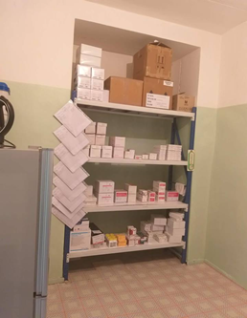
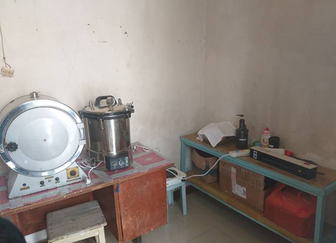
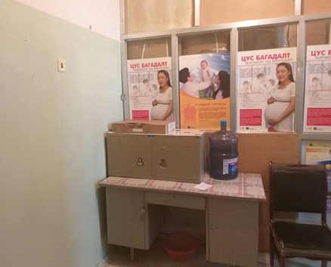
Disposition of disinfected TB sample
TB medicine storage room

Slide 8
Mongolian Association of Family Medicine Specialists (MAFMS in Uvs)
Achievements
Obstacles
Trained family centers’ TB physicians were conducting training to more than 200 children in general schools.
Every suspected sample are transported and 5-6 samples transported per month. 25 suspected tuberculosis samples were sent to sputum examinations and 16 had tuberculosis, one of which was smear positive tuberculosis in 2018. (TB has never diagnosed before.)
The MAFMS has published primary forms of tuberculosis (TB) primary care funded by the Global Fund.
The main problem facing MAFMS is lack of accommodation and DOT’s room.
Suggestions
Inadequate medicines’ room for patients with MDR-TB;
Short supply of sputum container. Currently, receives sputum container from the DOH.
There are 120 volunteers in a province, needs to be encouraged and receive incentives.
Shortage of manuals for citizens and nurses;

Slide 9
CCM suggestions to Uvs province
STI screening is insufficient and needs to be improved
In and protection of equipment provided by The Global Fund;
Consider on human resource sustainability; Doctors’ retraining (There isn’t an STI specialist/doctor);
Consider maintaining patients’ confidentiality.

Slide 10
Department of Health in Zavkhan province
  TB sample transportation cost of 1649.8 thousand MNT disbursed, in order to increase early detection of tuberculosis
  A mobile digital X-ray apparatus supplied according to the A/361st order of the Health Minister, which marked HF 120/60 and worth of 184.3 million MNT,
  Within the framework of WHO "Expansion of Mobile Technology Application for Primary Health Care" project: A total worth of 55.7 million MNT of expert equipment was supplied to the General hospital of Zavkhan province.

Slide 11
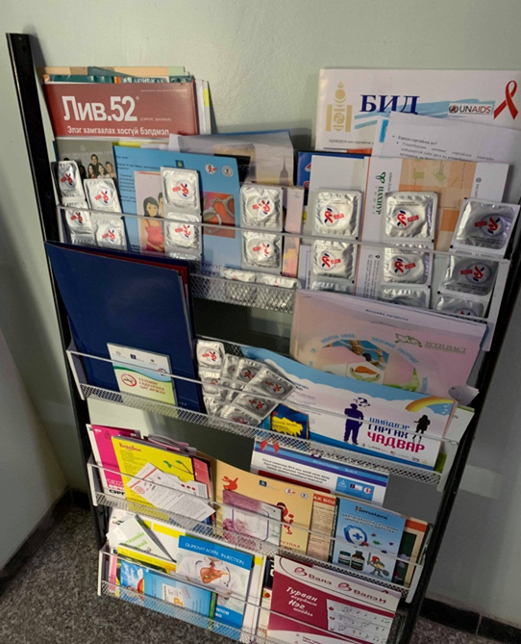
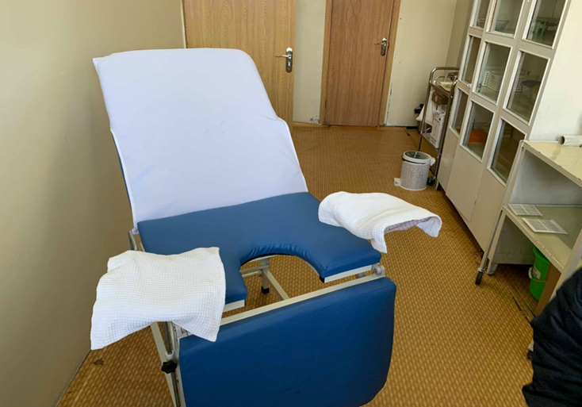
STI cabinet and VCT center
Condition
Obstacles
An HIV case detected and treated in the province. (STI cabinet was dark and unventilated. Therefore, STI cabinet moved to a new room.)
To increase the supply of condoms and distribution materials;
The microscopy required for syphilis and Trichomoniasis diagnosis; Sample quality can be lost while transporting to the medical laboratory, hence the risk of analytical error is high. In that reason need to purchase a thermostat.
A laboratory desk and chair supplied by the Global Fund in 2011. The table was not assembled until now. (Screw bolts were incomplete. Did not request a change or return.)

Slide 12
The TB dispensary of Zavkhan province
Obstacles
Condition
TB dispensary rooms are inadequate.
HIV/STI cabinets situated in the DOT’s room.
TB treatment rooms, laboratories, and medicines’ storage are all in one place.
Tuberculosis drugs are not stored in a pharmaceutical storage room.
Human resource shortage. A doctor does all the jobs, such as a physician, a registrar, a nurse, a dispensary doctor, and a doctor.
A microscope has been used since 1996, outdated and needs to be replaced
The first Tb case was diagnosed in 2011. As of January 2019, 13 TB cases were detected. 46% (n=6) of these cases were reported in Uliastai, 54% in Aldarkhaan, Tosontsengel, Durvuljin, Tes and Otgon soums. 10 out of 13 incidences were get treatment, 70% of them recovered, 10% died, 10% failed and 10% lost control.

Slide 13
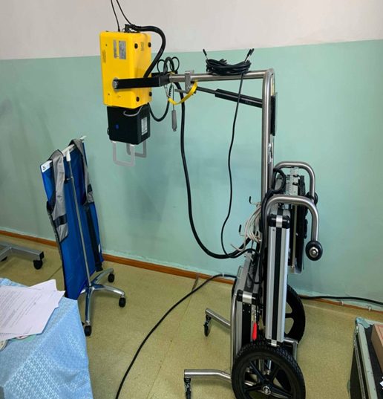
The list of the GF supported procurements
№ | Equipment | Country | Date | Serial | quantity
1 | Microscopy (electrons for eyes) | Japan | 1996 | Olmpus | 1
2 | Desar | Russia | 2009 | Кронт | 1
3 | Autoclave (portable) | China | 2008 | YX-280D | 1
4 | Quartz (portable) | China | 2006 | SJD-I | 1
5 | Electric scale | England | 2009 | ADAM | 1
6 | Refrigerator | Mongolia | 2013 | Монел | 1
7 | Personal computer (Dell) | China | 2013 | Dell | 1
8 | Mobile digital X ray apparatus | USA | Nov 2018 | HF 120/60 | 1
9 | Gene-Xpert |  | 2018 | With 4 modules, laptops, and adapter kits
Mobile digital X-ray apparatus

Slide 14
Mongolian Association of Family Medicine Specialists (MAFMS)
Achievements
MAFMS, NCCD jointly organized “Zero TB in Province” to governors of the province and “Capacity building for FHS doctors“ to doctors and specialists in May 2018, which were funded by the Global Fund
The Global Fund-supported primary TB forms provided by the MAFMS.
Few samples’ containers provided by the TB dispensary.
3 trainings were conducted and 15 people were informed about tuberculosis.
Urgamal soum in Zavkhan province
2 TB cases detected at the soum, in 2018. Suspected sputum samples transported to and analyzed at the Province hospital.
For STIs, congenital syphilis was detected in last year.
Incorrect reports of registers and records.
There aren’t any TB primary form.

Slide 15
CCM suggestions to Zavkhan province:
Maintain regular TB early screening and diagnosis;
News and reports need to be accountable and thorough;
Move STI cabinet from the TB dispensary;
Immediately remove the TB department and laboratory to the different locations;
Provide full infection control;
Provide primary TB form to the soum hospital and teach them how to fill the form.
Improve doctors’ knowledge and skills, make a proper selection of doctors, maintain the the sustainability of doctors.
Adequate usage of high-cost mobile X-ray apparatus, organize the inspection thoroughly;
Maintain confidentiality of patient's health and all employees of the hospital need to attend Human Rights training.

Slide 16
The main conclusion
Tuberculosis
Maintain regular TB early screening and diagnosis
High-cost equipment not properly installed, need to improve the situation (portable digital X-ray apparatus);
Improve the use of expensive equipment and stabilize the inspection;
Consider on storage of medicines and need to store in the Warehouse of the General Hospital;
Improve supervision on Soum hospitals’ implementations;
Immediately modify the infection control regime in TB dispensary of Zavkhan aimag;
There is no mechanical ventilation system for TB department and dispensary;
To build a good working environment for employees;
Consider human resource sustainability;

Slide 17
The main conclusion
HIV/AIDS/STI
Maintain regular STI screening and diagnosis
Early detection and testing are insufficient. The Health Minister's 305th order not enforced since it has approved in 2017;
The sample handling procedure is lost, the risk of sample quality loss is high;
There is no involvement of NGOs activities for Target group.
Patients' health condition not protected and high risk of collapse;
The University of Science and Medicine of Mongolia and the private universities provide insufficient knowledge and skills, pay attention to the quality of Doctors’ retraining;
Improve doctors and medical personnel' human rights knowledge and understanding, and maintain human right-based healthcare services, they also need to attend Human Rights training.

Slide 18
The main conclusion
CCM Oversight Committee
Review and revise the Terms of Reference of the project implementation oversight and site visit procedures.

Slide 19
Thank you for your consideration.

